Slide 1
Convolutional AutoEncoder (CAE)

Slide 2
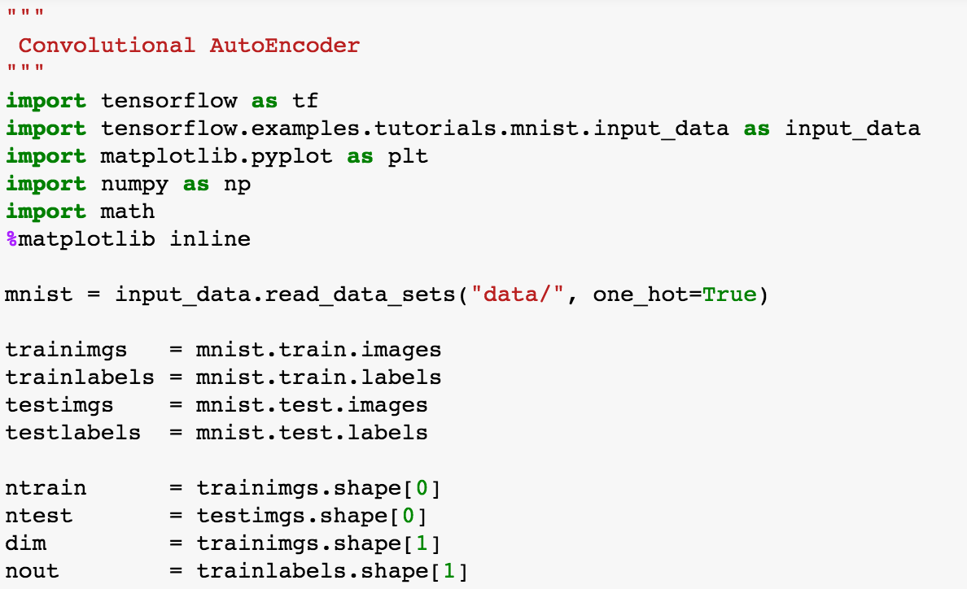
Import packages

Slide 3
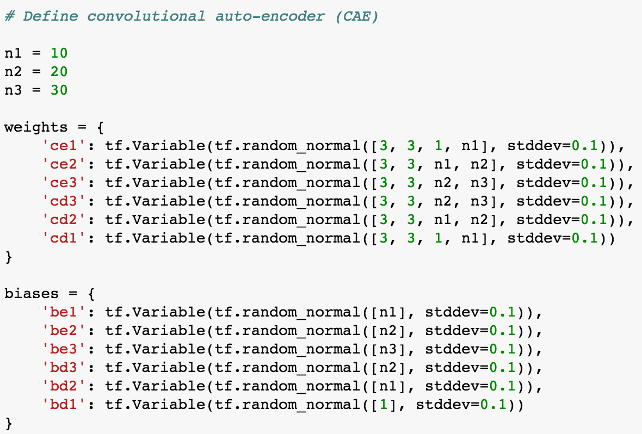
CAE
1
x n1
n1
x n2
n2
x n3
n2
x n3
n1
x n2
1
x n1

Slide 4
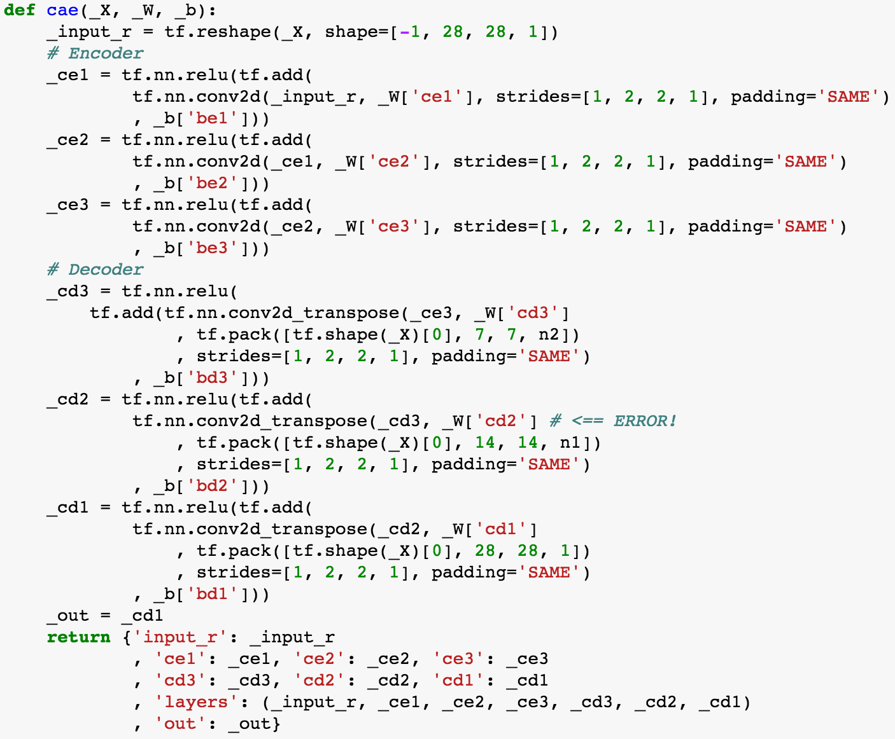
CAE

Slide 5
CAE

Slide 6
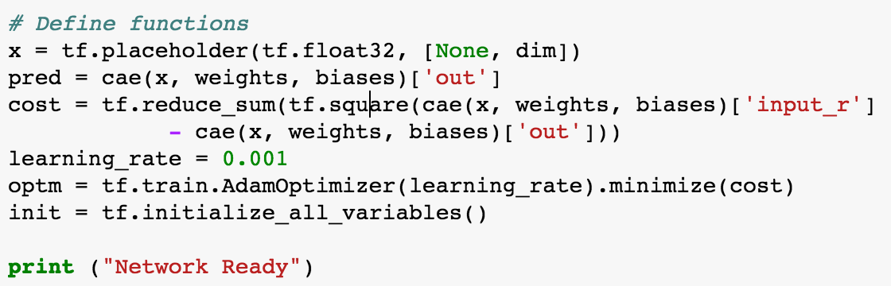
Functions

Slide 7
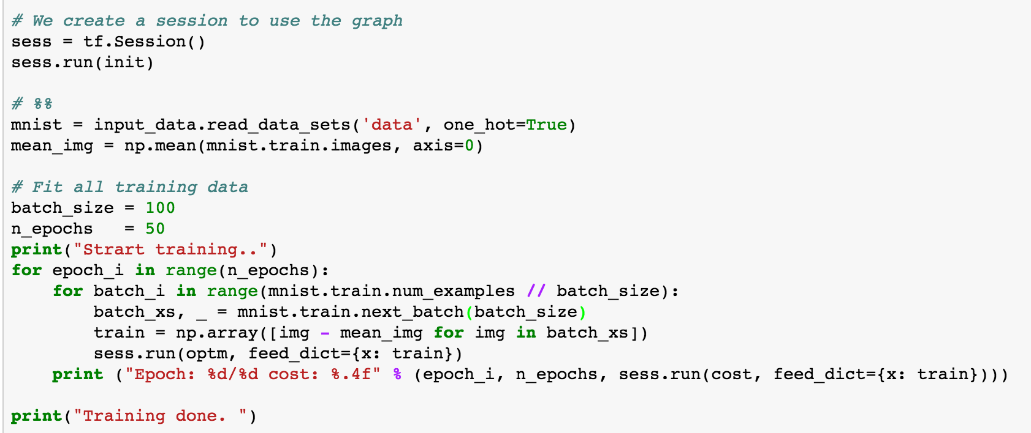
Run

Slide 8
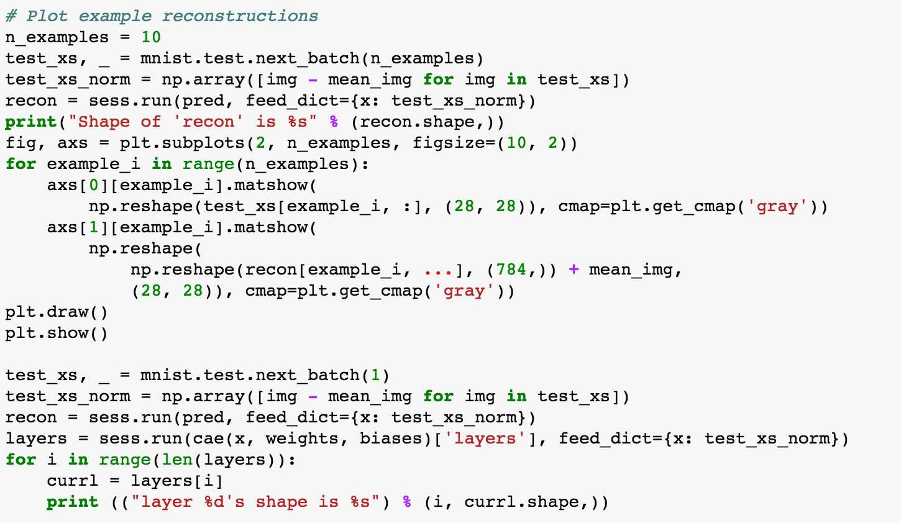
Plot

Slide 9
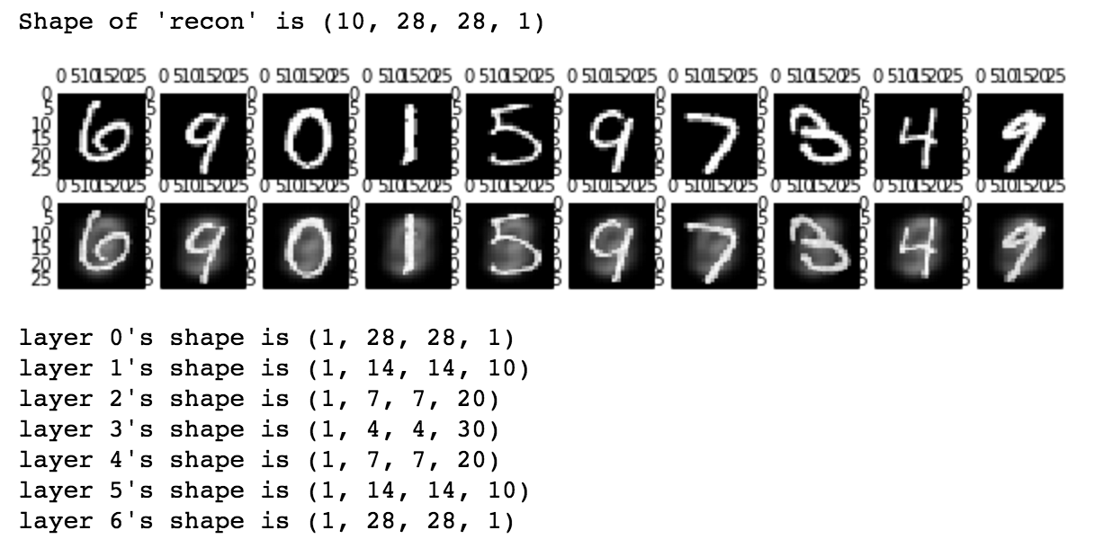
Plot

